Slide 1
Notes:
Hello Everyone.

Slide 2
Michelin's Semantic Analyzer

Slide 3
Contents
At this phase of the project, few important things to take a note of are:
1. Analysis and implementation of Semantic Analyzer.
2. Symbol Table.
3. Working of the Semantic Analyzer.
4. Implementations to be done.

Slide 4
Implementation of Semantic Analyzer
The job of a semantic analyzer is to check the type definition errors; no declaration or redeclaration of variables/classes/ functions; and any misuse of reserved identifiers.
In Michelin, the Semantic analyzer first creates the Symbol Table from the given token stream by the Parser. Then for every variable and it's declaration, semantic analyzer checks the symbol table and verifies if the appropriate rules are followed.

Slide 5
Implementation of Semantic Analyzer
Then the Semantic analyzer checks if all the arithmetic operations performed are of the likewise variable types and is allowed.
The assigned values to the appropriate variables are then checked to see if the data types are matching or not.

Slide 6
Symbol Table
Symbol Table is an essential data structure in a compiler which keeps track of the information about the scope and binding information about names, information about instances of various variables, function names, classes, objects, etc.
In Michelin, we built our Symbol Table using Ocaml's inbuilt hash table feature as it is mutable and also the operations such as find need constant time complexity for hash table.

Slide 7
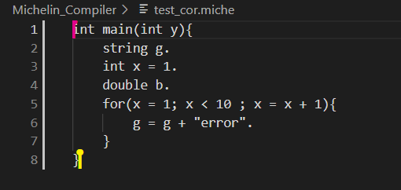
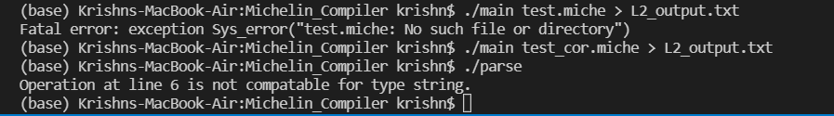
Working of the Semantic Analyzer
Input code:
Semantic error:

Slide 8
Further Additions Yet to be Done
We are yet to check the semantic errors faced by classes and functions and the variables passed into them.
In particular, some things that we haven’t handled as of now include:
Functions with the same definition;
Classes with the same definition;
Functions and Classes having the same name;
Type checking for function arguments;
Insertion of certain special datatypes.
1D array related stuff.

Slide 9
Team Details

